Slide 1
Bank Credit Classification Project
Predicting Credit Scores Using Machine Learning
Team Member: Hisham Alqanneh
Date: 2025

Slide 2
Project Overview
Objective: Develop a classification model to predict bank credit scores
  Data Exploration & Preprocessing
  Model Training (3+ algorithms)
  API Development (Flask)
  Streamlit Demo Application
  Full Documentation

Slide 3
Data Sources & Structure
Dataset: Bank_Credit.xlsx
  Training Data: 98,800+ records
  Test Data: 1,000 records
  11 Predictive Features
  Target Variable: Credit_Score (3 classes)
  Numerical: Age, Annual_Income, Interest_Rate, Outstanding_Debt, etc.
  Categorical: Credit_Mix, Payment_of_Min_Amount

Slide 4
Exploratory Data Analysis
Correlation Heatmap
  Identified high correlation between Annual_Income and Monthly_Inhand_Salary
  Guided multicollinearity treatment using VIF analysis
  Interest Rate Distribution
  Concentrated between 5–11% with normal-like distribution
  Credit Score Distribution
  Standard: 53.17%, Poor: 29.03%, Good: 17.80%
  No severe class imbalance detected

Slide 5
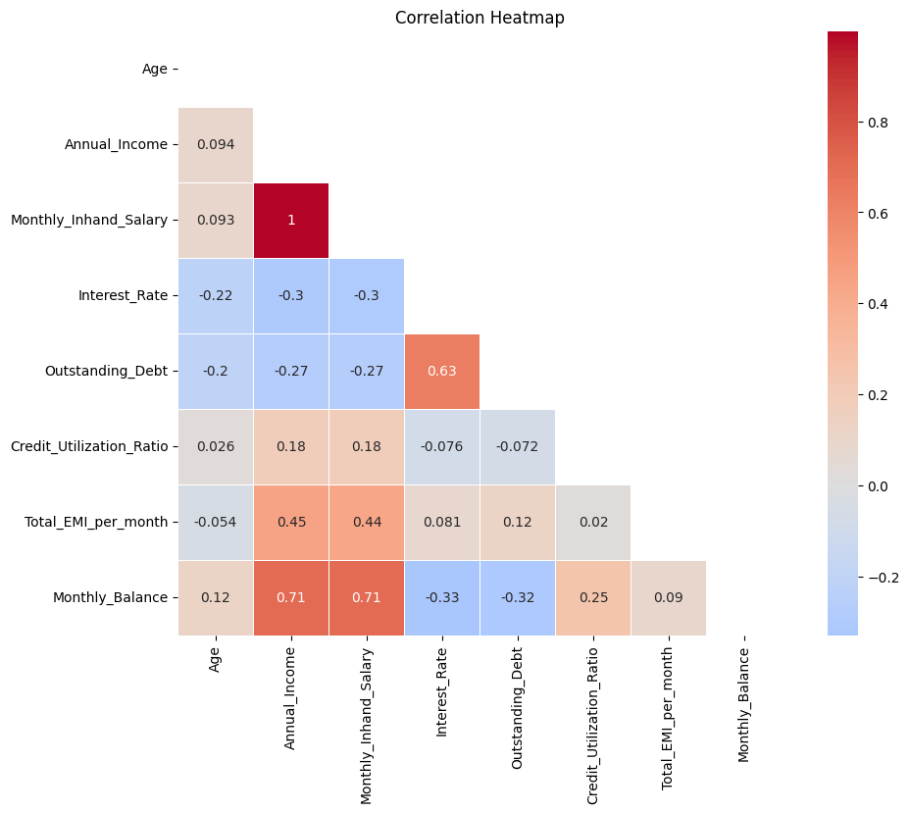
Correlation Heatmap
  Identified high correlation between Annual_Income and Monthly_Inhand_Salary
  Guided multicollinearity treatment using VIF analysis

Slide 6
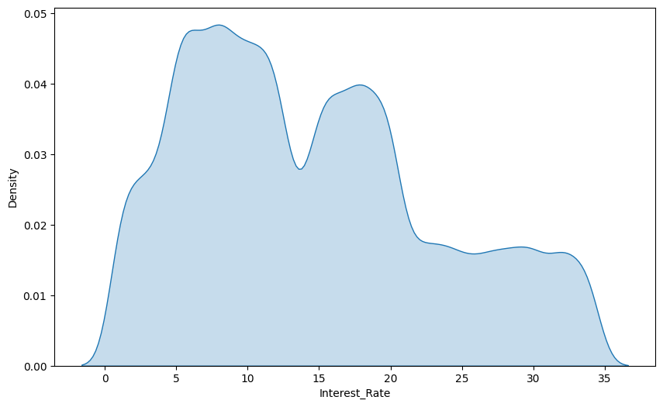
Interest Rate Distribution
Concentrated between 5–11% with normal-like distribution

Slide 7
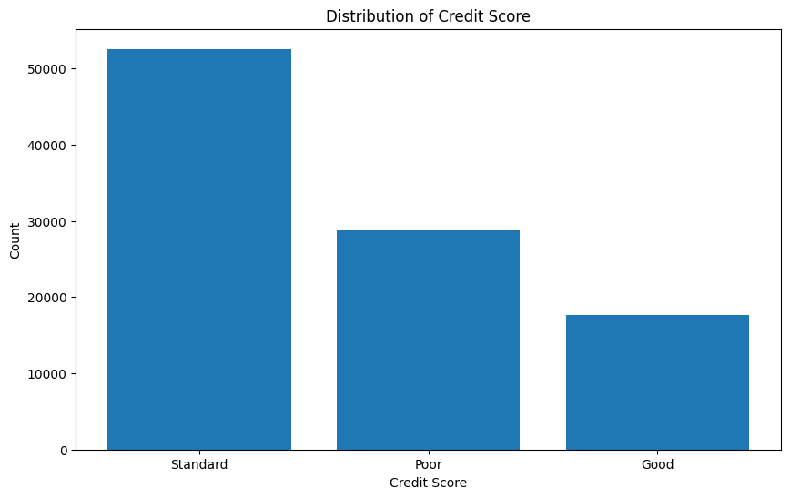
Credit Score Distribution
  Standard: 53.17%, Poor: 29.03%, Good: 17.80%
  No severe class imbalance detected

Slide 8
Data Preprocessing Pipeline
Removed 50 records with missing values (<0.05% of data)
  Dropped ID column (non-predictive)
  One-Hot Encoding for categorical variables
  Binary flags for Credit_Mix and Payment_of_Min_Amount
  Applied StandardScaler to all numerical features
  Outlier analysis via box plots – outliers retained

Slide 9
Multicollinearity Treatment
Variance Inflation Factor (VIF) analysis performed
  Monthly_Inhand_Salary VIF > 270
  Extreme multicollinearity with Annual_Income
  Removed Monthly_Inhand_Salary
  Final VIF scores < 2.1 for all features
  Improved interpretability and reduced overfitting

Slide 10
Model Selection Rationale
Neural Network (Logistic Regression Variant)
  Baseline model with interpretability
  Two architectures tested
  XGBoost (Ensemble) – robust to non-linearity
  Random Forest (Ensemble) – handles high-dimensional data
  Evaluation: Accuracy, Precision, Recall, F1-Score

Slide 11
Model Training Results
Neural Network 1: 2 hidden layers, 30 epochs – 67.47%
  Neural Network 2: 4 hidden layers, 50 epochs – 69.08%
  XGBoost 1: 100 estimators, depth=4 – 68.88%
  XGBoost 2: 300 estimators, depth=6 – 66.37%
  Random Forest (GridSearchCV) – 69.38%
  Best Model: Random Forest

Slide 12
Model Evaluation Metrics
Random Forest Test Performance
  Accuracy: 69.38%
  Weighted F1-Score: 0.70
  Macro Precision: 0.68
  Good recall for 'Good' class: 79%
  5-fold Cross-Validation applied

Slide 13
API Development (Flask)
Flask backend with CORS support
  RESTful API design
  POST /predict/logreg
  POST /predict/xgb
  POST /predict/rf
  Input: JSON feature array
  Output: Class probabilities

Slide 14
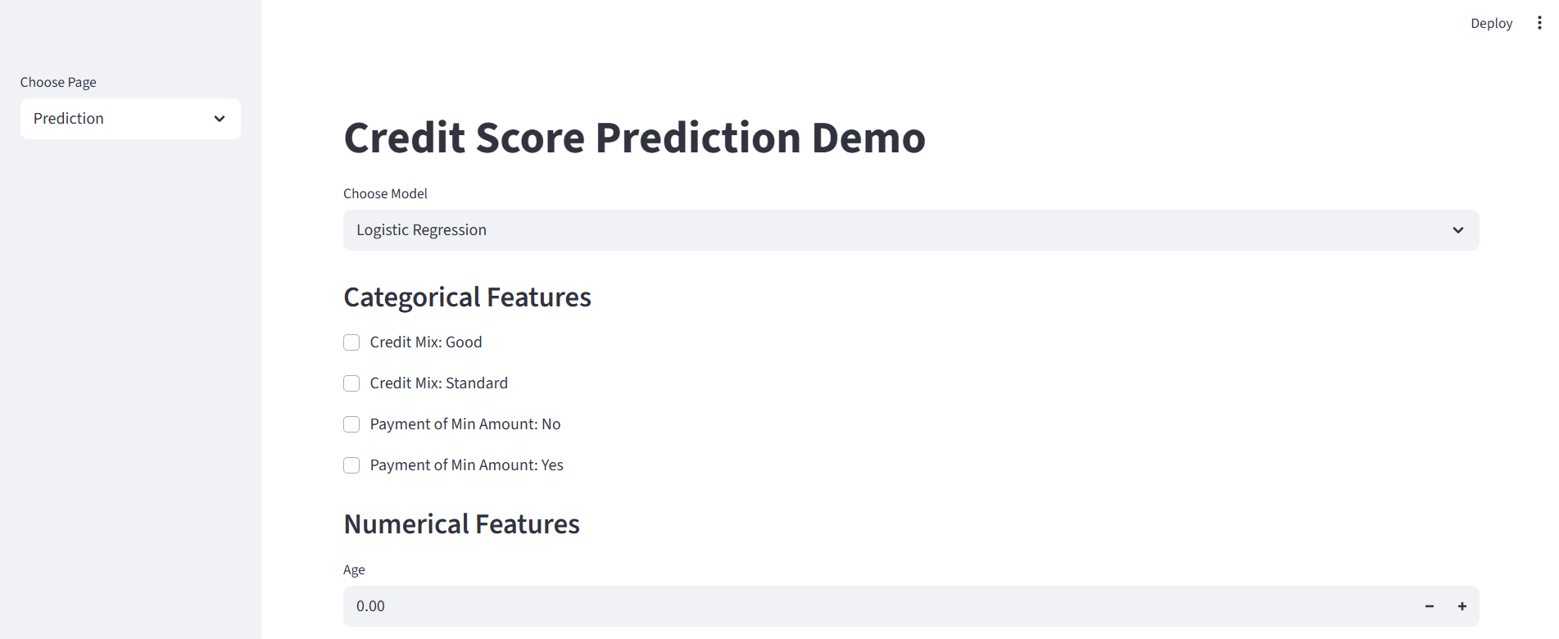
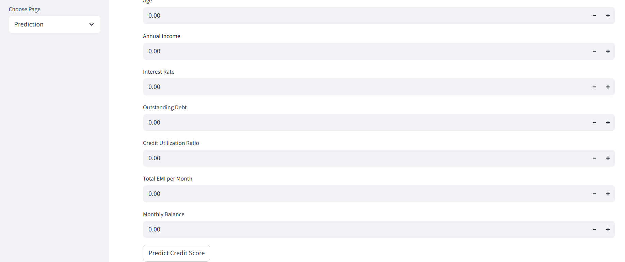
Streamlit Frontend Application
Prediction Demo page
  Model selection and feature input
  Real-time Flask API calls
  Training Results Dashboard
  Accuracy/Loss visualization
  CSV-based metric display

Slide 15
Deployment & Code Structure
Vscode for training
  Flask backend
  Streamlit frontend
  Saved model files
  Version control using GitHub

Slide 16
Key Technical Insights
Income features highly correlated
  No need for class balancing
  Random Forest outperformed deep models
  Feature engineering more impactful than depth
  Flask is lightweight and scalable

